Slide 1


Credit Default Prediction: Project Overview & Dataset
Name: Aakash Sachin Nikam Student No.: 20054691 Professor: Alexander Victor
B9DA108 Programming for Data Analysis CA - 2

Slide 2
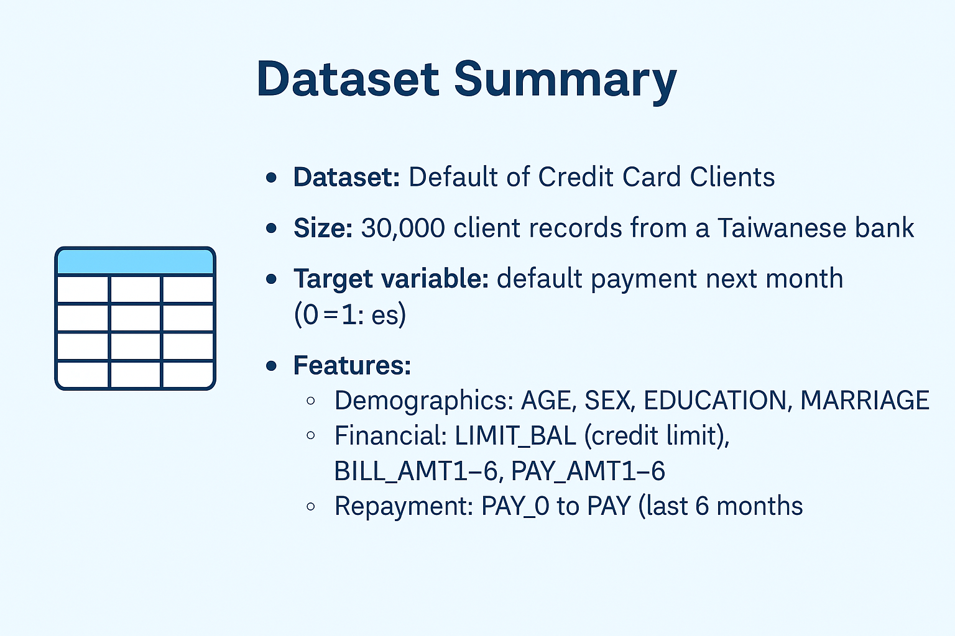
Data Preprocessing & Exploratory Analysis

Slide 3
Data Preprocessing & Exploratory Analysis
Preprocessing Steps
Fixed header and renamed default payment next month to default
Dropped non-predictive ID column
Verified: no missing data, all numeric
Handled class imbalance with class_weight='balanced’
EDA Insights
Histograms: Most clients aged 25–40; credit limits < 200,000
Boxplots: Revealed high outliers in billing & payment
Countplots: Slightly more defaults in males, singles, university grads
Heatmap: Strong correlation between PAY_0–PAY_6 and default

Slide 4
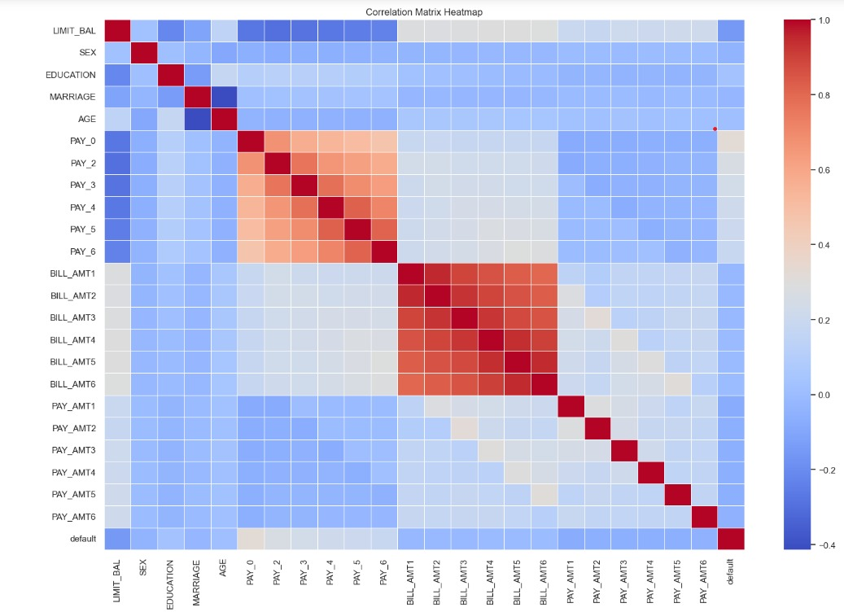
Modeling Approach & Evaluation Strategy
Models Used
Logistic Regression: Plain & weighted (class_weight='balanced’)
Decision Tree Classifier
Random Forest Classifier
Trained on 80% of data, tested on 20% Implemented using scikit-learn
Evaluation Metrics Table
Logistic Regression failed to predict defaulters due to class imbalance.
Weighted Logistic Regression improved recall but lost accuracy.
Decision Tree balanced performance and interpretability.
Random Forest had the best overall performance, especially in precision.
Model | Accuracy | Precision (Default=1) | Recall (Default=1) | F1-Score
Logistic Regression | 78% | 0% | 0% | 0
Weighted Logistic Regression | 56% | ~35% | 73% | Moderate
Decision Tree Classifier | 73% | ~38% | 40% | ~39%
Random Forest Classifier | 81.50% | 65% | 34% | 45%

Slide 5
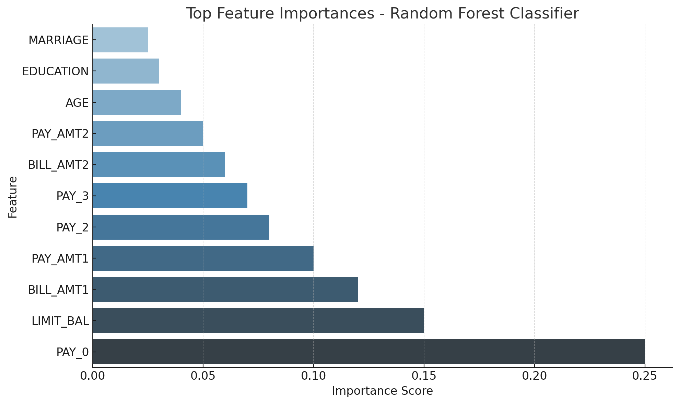
Results & Key Insights
Exploratory Insights
22% of clients defaulted → Imbalanced target
Most clients were aged 25–40 with credit limits < 200,000
Slightly higher default among males, singles, and university grads
Strongest correlations with default: PAY_0–PAY_6 (repayment history)

Slide 6
Discussion, Limitations & Conclusion
Discussion / Key Takeaways
Recent repayment behavior (PAY_0) is the most powerful indicator of default
Credit limit and trends in bill/payment amounts were strong predictors
Demographics (AGE, SEX, MARRIAGE) were less predictive
Random Forest had the best overall model performance.
Limitations
Recall for defaulters (34%) is modest — some defaulters go undetected
Dataset is static — lacks external factors (e.g. employment, inflation)
Imbalanced classes posed challenges in model sensitivity
Conclusion & Future Work
Random Forest offers reliable, real-world applicable results
Future improvements:
Add behavioral/economic variables
Use ensemble models like XGBoost or LightGBM
Apply hyperparameter tuning for optimal results

Slide 7
Thank You!!

